Slide 1
TuneTribe
Mauricio, Shauna, Emmanuel, Kannan

Slide 2

What is TuneTribe?
TuneTribe is a social platform designed for music enthusiast and artists alike. A place where people can share their music taste and where small artists can grow their follower base.

Slide 3

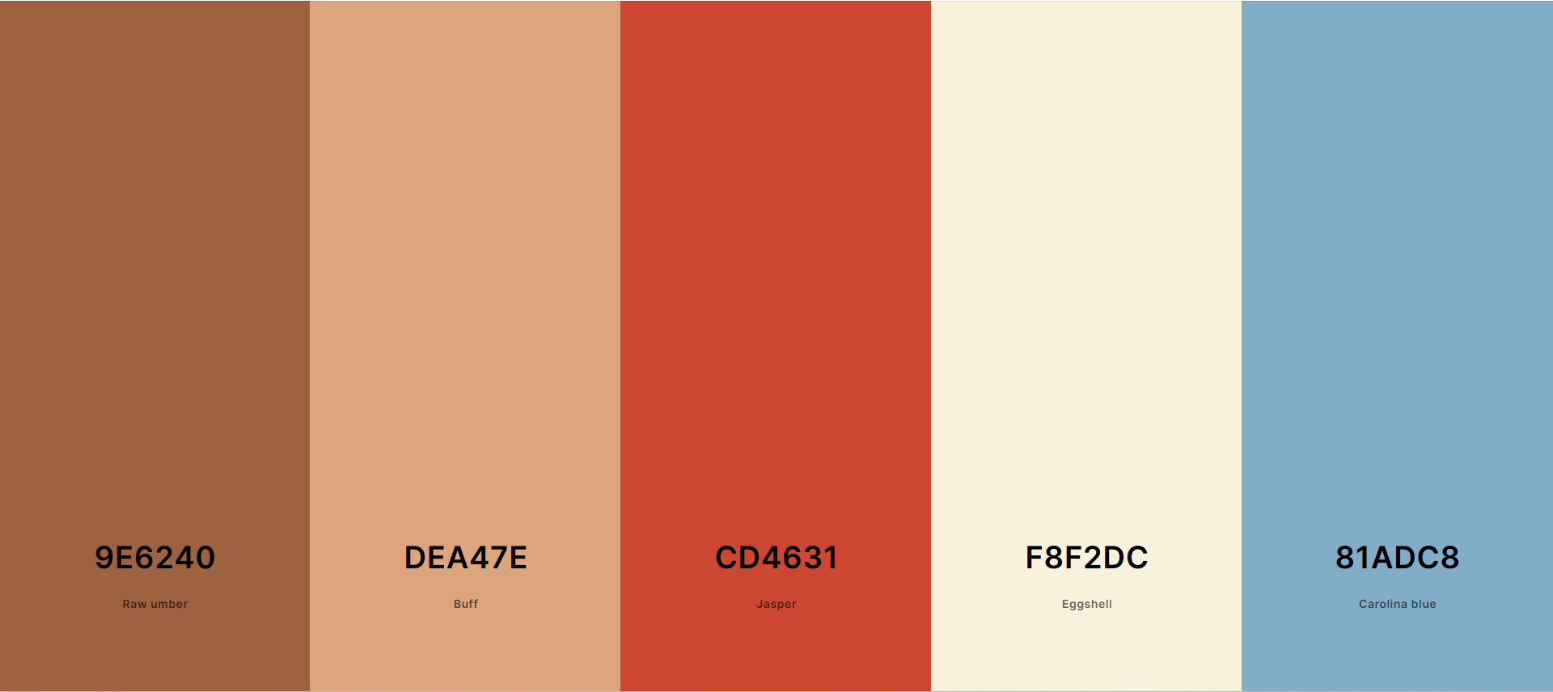
Logo and Color Palette

Slide 4

Who are the users?
Normal Users
Artists
Moderators
Admins

Slide 5
Normal User
Create a post
Short Caption
Song name and disc art
Comment on posts
Add songs to profile
Display your favorite songs
Generate artist recommendation
Based on the music they listens to
Recommend songs to tribe mates
Login

Slide 6
Artist
Link song information
Link Spotify, apple music
Access music report
How many people see the post
Access royalty info
Friend other Artists
Login

Slide 7
Moderator
Delete comments
Temporarily ban users
Limit users from commenting
Send ban request for users
Delete posts
Login

Slide 8
Admin
Ban Users
Ban Artists
Uploading unauthorized content
Remove moderator permission
Comments
Banning
Remove artist permission
Music upload
Managing profile
Login

